Slide 1
Chapter X
Output Merger

Slide 2
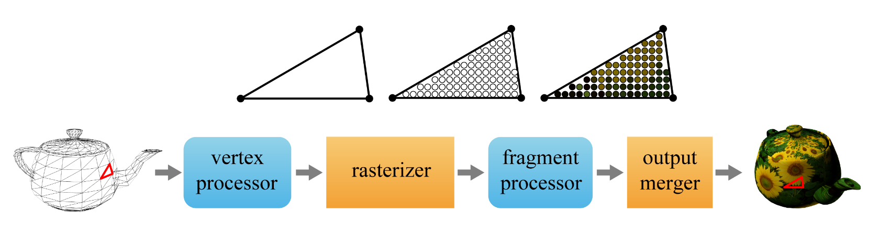

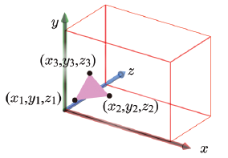
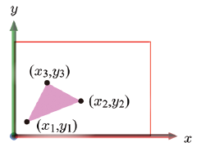
Where are We?
We’ve just left the fragment shader that operates on each fragment and determines its color through various operations such as texturing and lighting.
The fragment shader has processed screen-space fragments and we are still in the screen space.
10-<number>

Slide 3
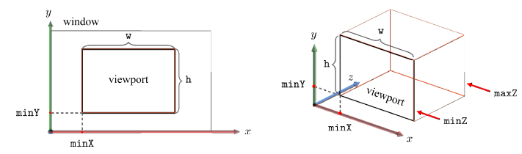
Color and Depth Buffers
GL supports three kinds of buffers.
  Color buffer is a memory space storing the pixels to be displayed on the screen
  Depth buffer or z-buffer has the same resolution as the color buffer, and records the z-values of the pixels currently stored in the color buffer.
  Stencil buffer will not be discussed in this class.
The collection of these three is called the frame buffer.
Given the following viewport, we have w×h-resolution color and depth buffers.
10-<number>

Slide 4
Z-buffering
The output of the fragment shader is often called the RGBAZ fragment.
  A: alpha for representing the fragment's opacity
  Z: depth
Using alpha and depth values, the fragment competes or is merged with the pixel of the color buffer.
Z-buffering
  When a fragment at (x,y) is passed from the fragment shader, its z-value is compared with the z-buffer value at (x,y).
  If the fragment has a smaller z-value, its color and z-value are used to update the color buffer and z-buffer at (x,y), respectively.
  Otherwise, the fragment is discarded.
10-<number>

Slide 5
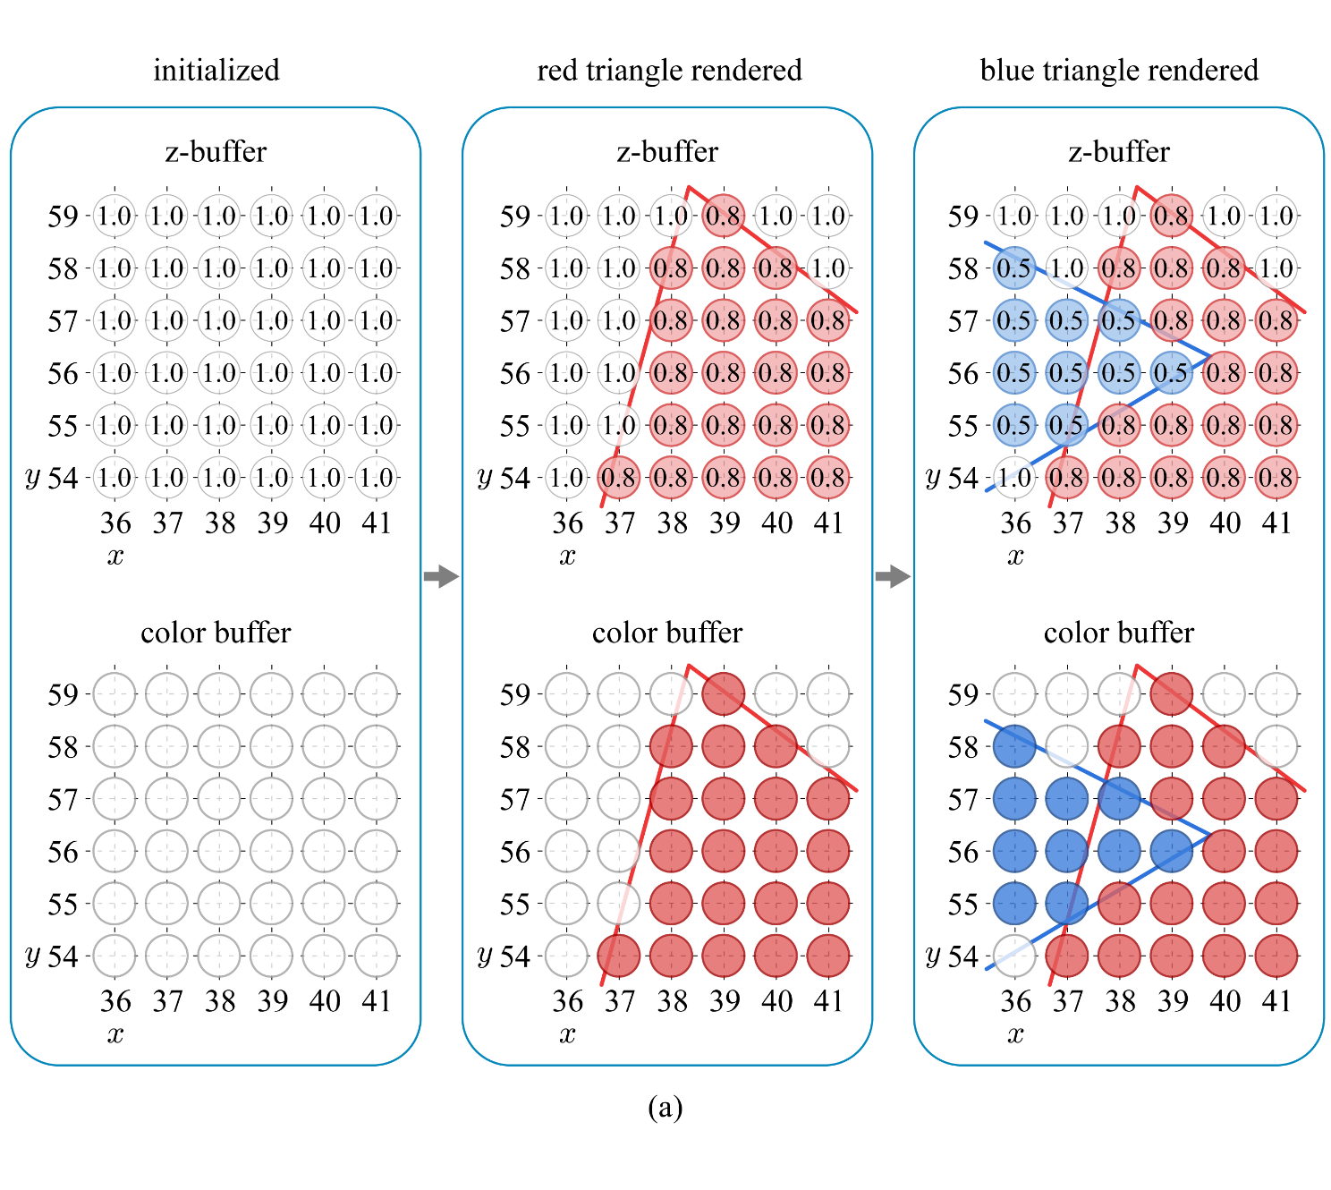
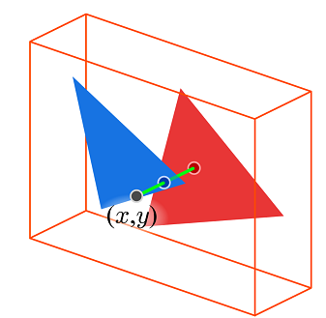
Z-buffering (cont’d)
Assume maxZ is 1.0, the red triangle’s depth is 0.8, and the blue triangle’s is 0.5.
10-<number>

Slide 6
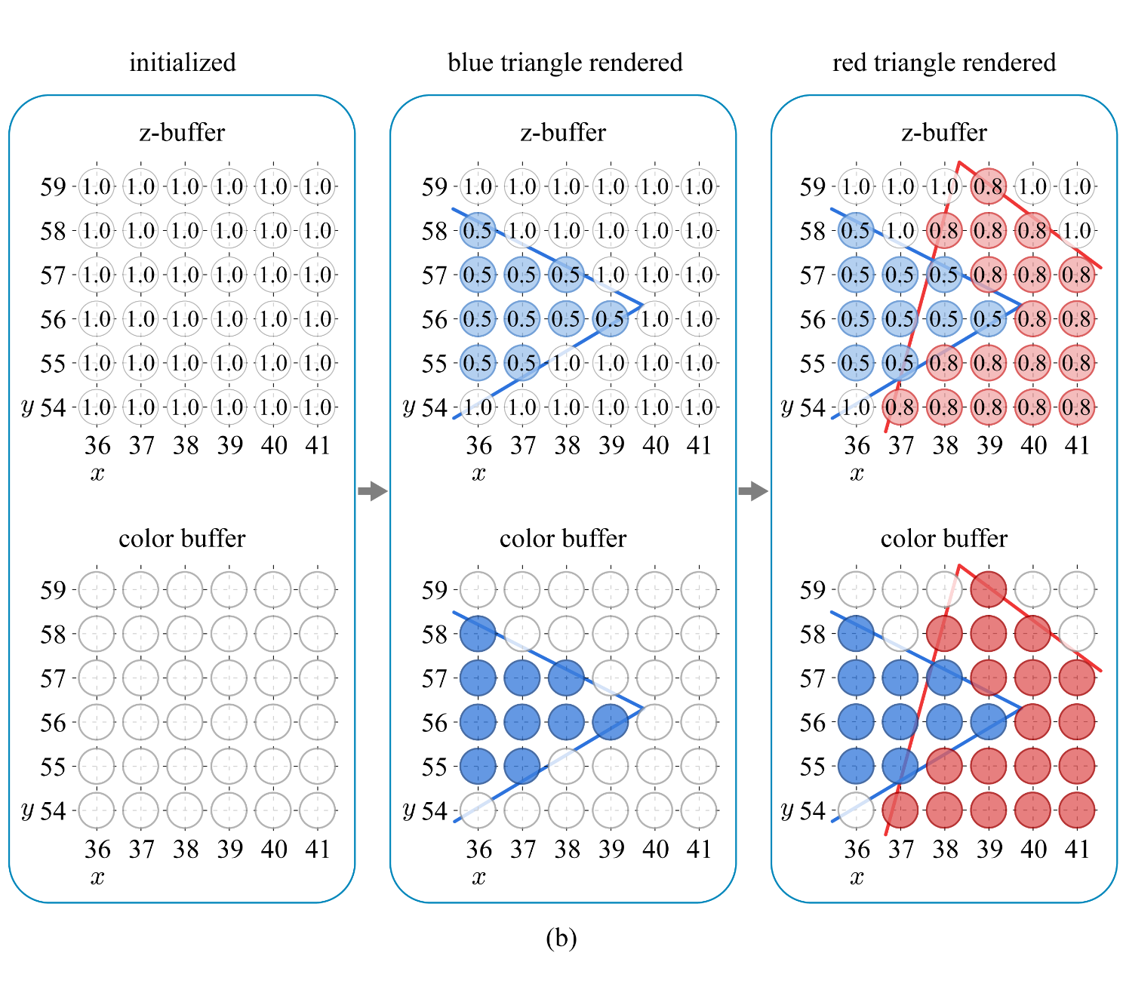
Z-buffering (cont’d)
Rendering-order independence!!
10-<number>

Slide 7
Z-buffering in GL
By calling glClear once per frame, three buffers are simultaneously cleared with the default values selected by the following:
  glClearColor
  glClearDepthf
  glClearStencil
All tests and operations on fragments are disabled by default and are enabled by calling glEnable with the following arguments, for example:
  GL_DEPTH_TEST
  GL_BLEND (for blending fragments with colors stored in the color buffer)
glDepthFunc(GLenum func)
  func specifies the conditions under which the fragment is drawn.
  The default is GL_LESS, which means that the fragment is drawn if its depth is less than that of the pixel.
10-<number>

Slide 8

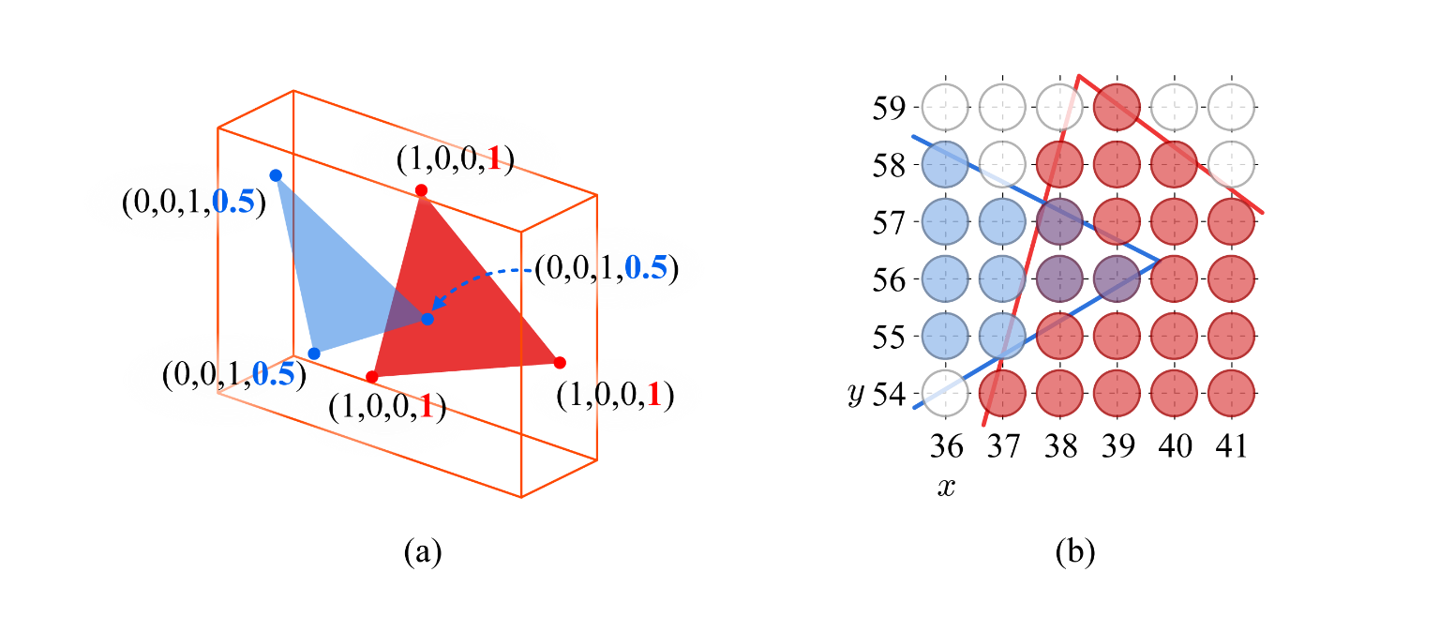
Alpha Blending
The alpha channel in the range of [0,1]
  0 denotes “fully transparent.”
  1 denotes “fully opaque.”
A typical blending equation is described as follows:
For alpha blending, the primitives cannot be rendered in an arbitrary order. They must be rendered after all opaque primitives, and in back-to-front order. Therefore, the partially transparent objects should be sorted.
10-<number>

Slide 9
Alpha Blending in GL
glBlendFunc(GLenum sfactor, GLenum dfactor);
  sfactor specifies the blending coefficient for the incoming (source) fragment
  dfactor specifies the blending coefficient for the destination pixel
Many values such as GL_ZERO and GL_ONE can be assigned to sfactor and dfactor, but GL_SRC_ALPHA may best fit to sfactor and GL_ONE_MINUS_SRC_ALPHA to dfactor.
Once the fragment and pixel color are multiplied by sfactor and dfactor, respectively, they are combined using the operator specified by glBlendEquation.
  Its argument can be GL_FUNC_ADD, GL_FUNC_SUBTRACT, GL_FUNC_REVERSE_SUBTRACT, GL_MIN, or GL_MAX.
  The default is GL_FUNC_ADD.
10-<number>

